Slide 1
Motion Graphs

Slide 2
By the end of this lesson, you should have a solid understanding of:
Displacement-time graphs
Velocity-time graphs
Acceleration-time graphs

Slide 3
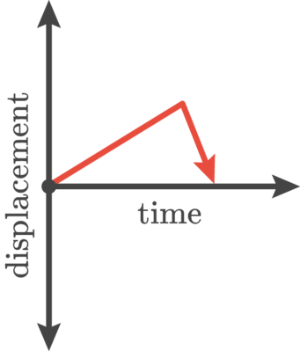
The first type of motion graphs we will review are displacement-time graphs.
These graphs show how the displacement of an object changes over time.
On these graphs, displacement is always plotted on the y-axis and time is plotted on the x-axis.

Slide 4
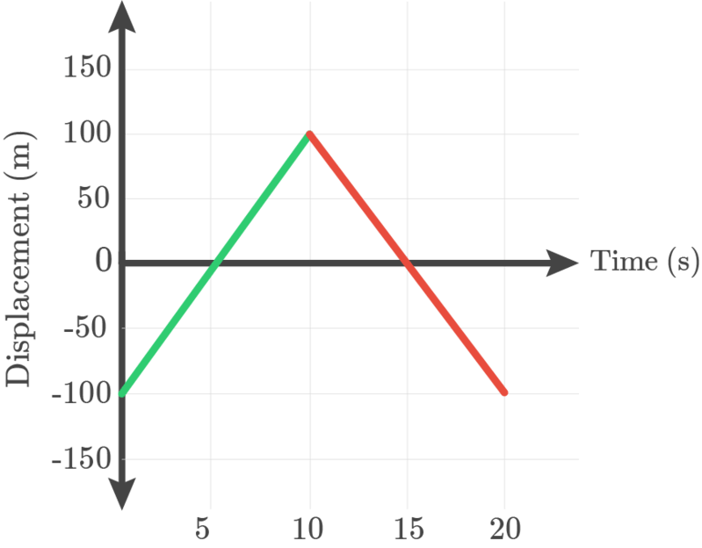
The gradient of a displacement-time graph gives the velocity of the object.
If the graph slopes down, the velocity is negative.
If the graph slopes upwards, the velocity is positive.

Slide 5
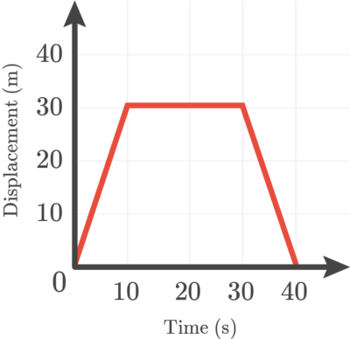
Displacement-Time graphs can also show if an object isn't moving.
If an object has a displacement-time graph with a flat line, the object is stationary. This means that it is not moving.

Slide 6
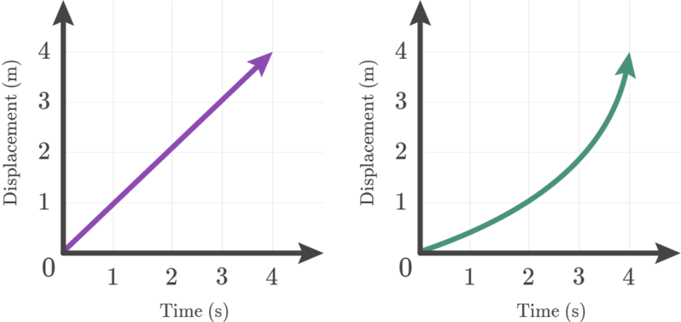
Constant velocity vs. increasing velocity
If a displacement-time graph has a straight line (left), the object is travelling at a constant velocity.
If the line is curved (right), it means that the object is accelerating.

Slide 7
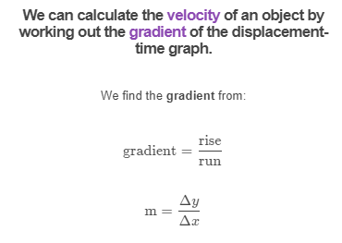
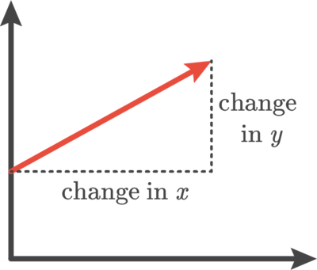

Slide 8
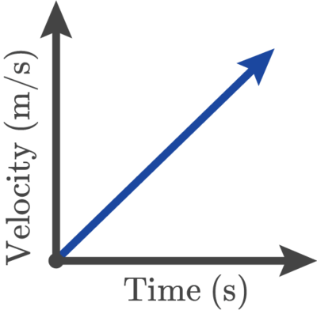
Velocity-time graphs show how the velocity of an object changes over time.
Time is mapped on the x-axis and velocity is on the y-axis.
This means that to find the velocity at a certain time, we just need to check the value on the y-axis.

Slide 9
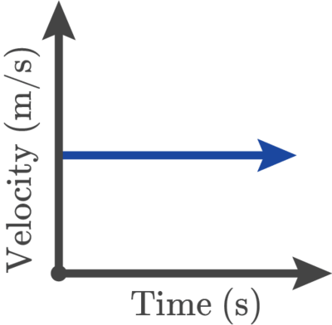
If an object is travelling at a constant velocity, it will be represented by a flat line on the velocity-time graph.
This means that the object is travelling at the same velocity at all times.

Slide 10
If an object is speeding up (positive acceleration), the graph slopes upwards.
This means that the object goes faster as time passes.

Slide 11
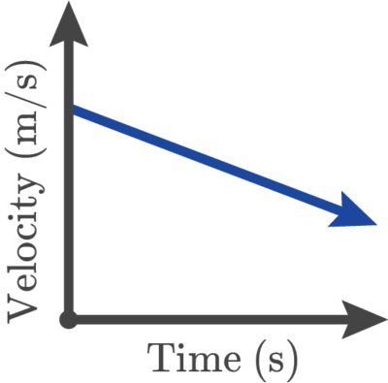
If the object is slowing down (negative acceleration), the graph slopes downwards.
This means that the object is travelling slower at the end of its journey than at the start.

Slide 12
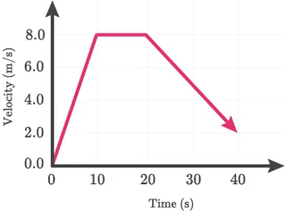
The area under a velocity-time graph tells us the displacement of the object in question.

Slide 13
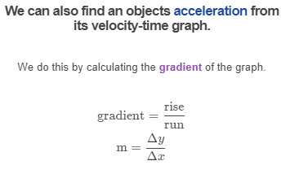
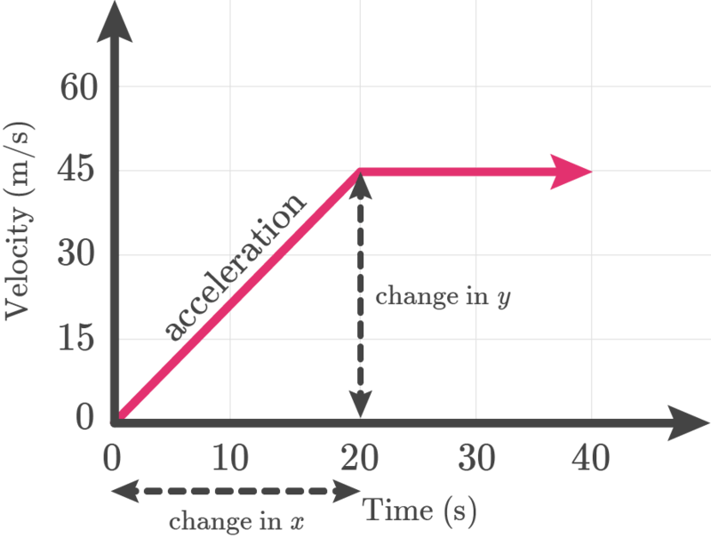

Slide 14

The last type of motion graph which you need to know about is the acceleration-time graph.
These graphs show how the acceleration of an object changes over time.
Acceleration is plotted on the y-axis and time is plotted on the x-axis.

Slide 15
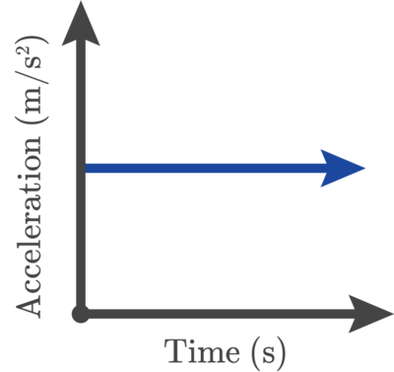
If an object is travelling with constant acceleration, the acceleration-time graph will have a flat line.

Slide 16
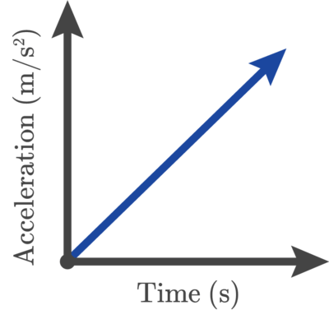
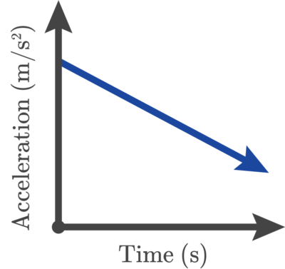
Acceleration and deceleration
When an object's acceleration is increasing, the acceleration-time graph slopes upwards.
An object with decreasing acceleration is represented by an acceleration-time graph that slopes downwards.

Slide 17
If the line on an acceleration-time graph is above the x-axis, the object has positive acceleration.
All three of these graphs show positive acceleration.

Slide 18
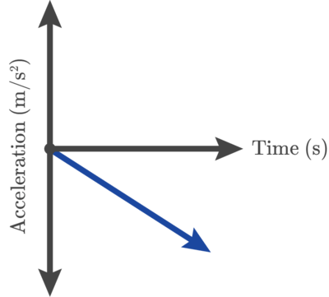
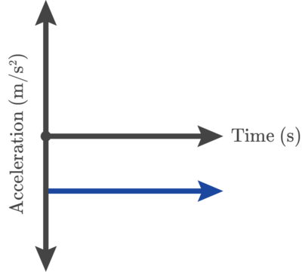
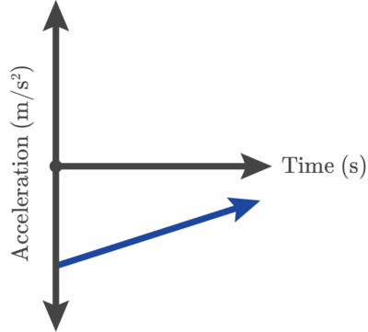
An object with negative acceleration has a line on the acceleration-time graph which is below the x-axis.
All three of these graphs show negative acceleration.

Slide 19
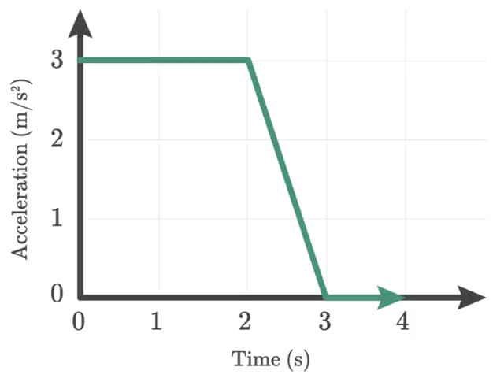
We can calculate the change in velocity of an object from an acceleration-time graph.
We do this by working out the area underneath the acceleration-time graph.

